Slide 1
FLIPKART GRID 6.0
-Shrikala R -Vishnu Gowda H P

Slide 2
Freshness Prediction
This code is a Python script that implements a machine learning pipeline for predicting the freshness of fruits based on images, using transfer learning with the MobileNetV2 model. It begins by loading images from a specified folder, where each fruit type has subfolders for "Fresh" and "Spoiled" images. The images are preprocessed by resizing them to 128x128 pixels, normalizing the pixel values, and associating the appropriate labels (1 for fresh, 0 for spoiled). The dataset is split into training and testing sets, and data augmentation techniques such as rotation, zoom, and flipping are applied to the training images to improve the model's generalization ability.
The code then constructs a convolutional neural network (CNN) using MobileNetV2 as the base model, which has been pre-trained on the ImageNet dataset. This base model is set to non-trainable, and additional layers are added to perform global average pooling, followed by dense layers for binary classification between fresh and spoiled fruit images. The model is trained using augmented data for 20 epochs, with the accuracy and loss evaluated on the test data afterward. The trained model is used to predict freshness levels for new images by resizing and normalizing the input image, then outputting a label (Fresh or Spoiled) along with a confidence percentage.
Additionally, the script includes a graphical interface for users to upload and analyze images. It utilizes the `Tkinter` library to open a file dialog where users can select an image, after which the model predicts the fruit's freshness and displays both the original and processed images using `matplotlib`. The program loops to allow users to scan multiple images, asking whether they want to continue after each prediction. This interface provides an easy-to-use method for performing image-based freshness prediction without needing to manually handle the files or preprocess them.

Slide 3
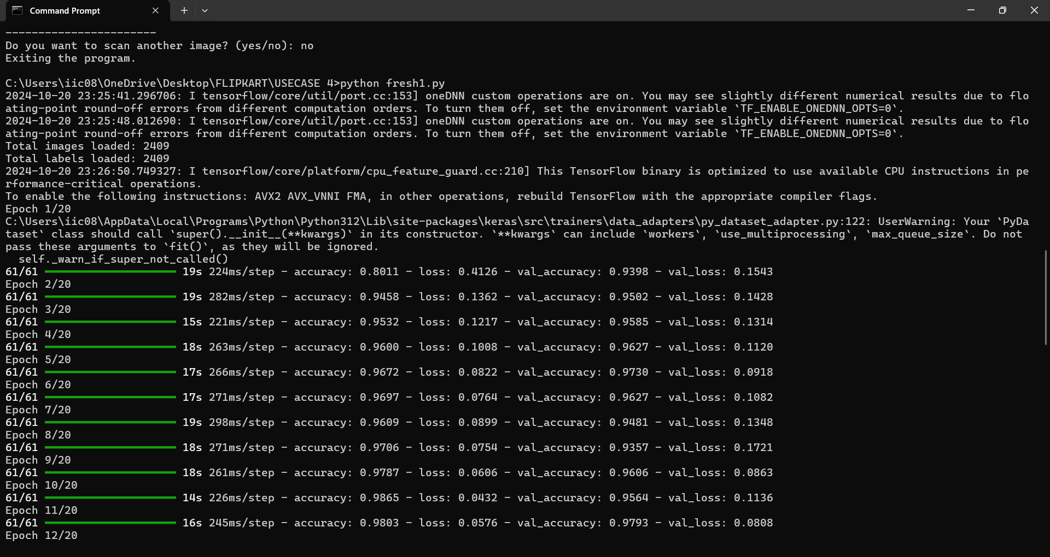

Slide 4
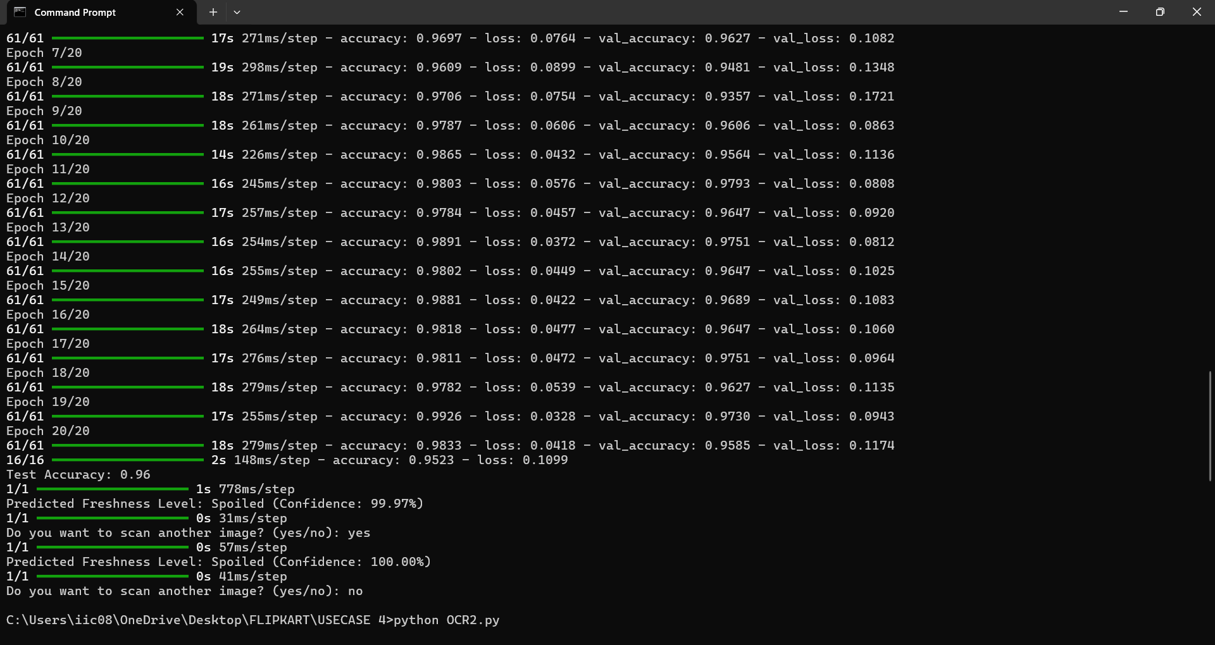

Slide 5
Product Data Extraction
This code implements a system to extract and process barcode data and product details from images, and it further attempts to retrieve manufacturing (MFG) and expiration (EXP) dates using Optical Character Recognition (OCR). The primary functionality revolves around selecting an image via a file dialog, scanning for barcodes, and retrieving the corresponding product information from the Open Food Facts API. The barcode scanning is done using the `pyzbar` library, and once a barcode is detected, the code makes an HTTP request to fetch product details like the name, brand, and nutritional information. If the product is found, its details are displayed to the user.
A unique feature of the system is its ability to preprocess the image to enhance OCR accuracy. The code preprocesses images by resizing them, adjusting contrast and brightness, and applying binary thresholding. Using Tesseract OCR, it extracts any text in the image that may contain MFG and EXP dates. These dates are then processed using a regular expression that matches various date formats. The system tries several parameter combinations to ensure the best possible OCR results, iterating over ranges of contrast, brightness, and threshold values. Once the MFG and EXP dates are successfully extracted, they are stored and displayed to the user.
Additionally, the system maintains a database that tracks how many times an image has been uploaded by calculating and storing its hash value. This database also stores extracted MFG and EXP dates for each unique image. After each scan, the system displays the stored data, allowing the user to review past uploads and their corresponding dates. The program repeatedly prompts the user to continue scanning more images, enabling a loop for batch processing multiple barcodes and images. Overall, the system combines barcode reading, API integration, image preprocessing, and OCR to automate the extraction and management of product data.

Slide 6
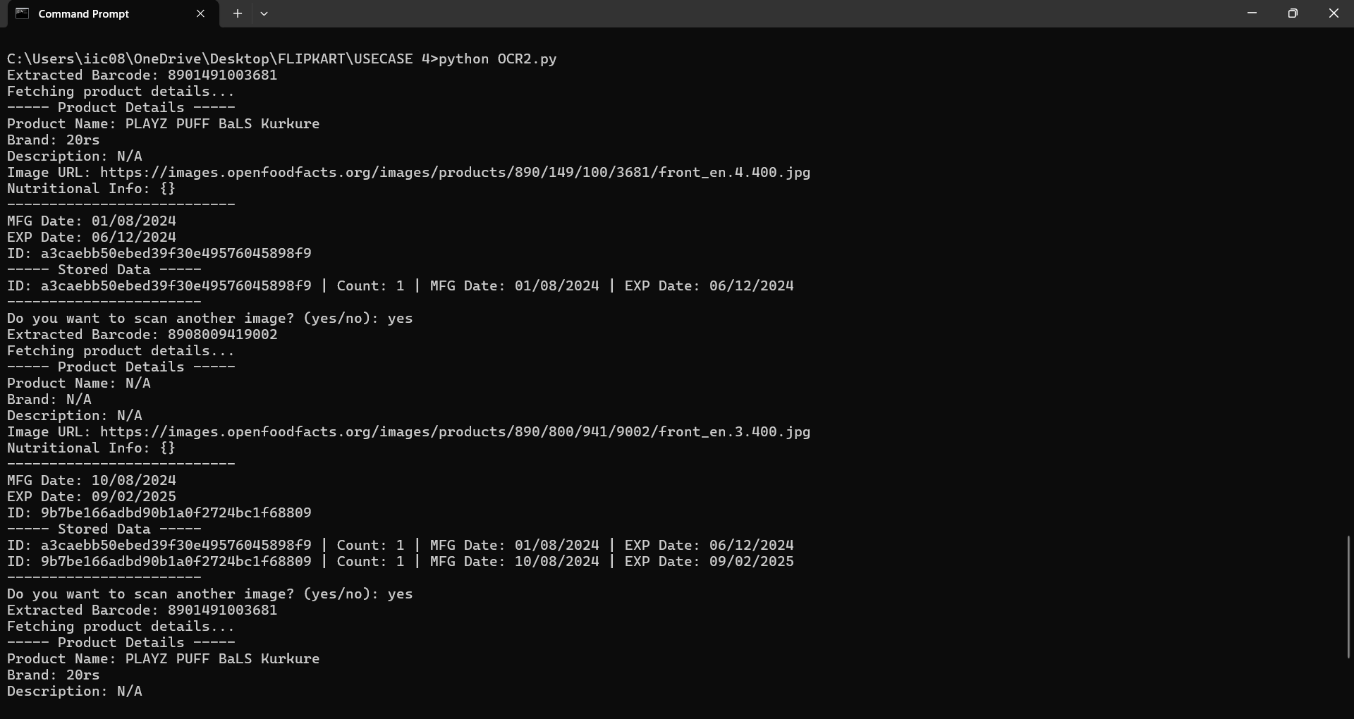

Slide 7
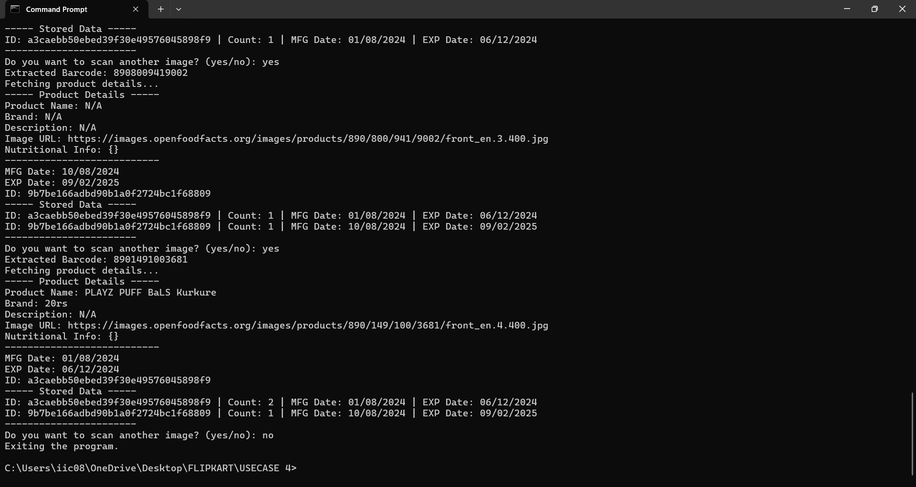

Slide 8
https://github.com/shrikala05/vishnu-shrikala-GRID/tree/main

